Slide 1

MoH Data Catalog
A first step towards Interoperability & Open Data

Slide 2

Introduction

Slide 3
Data Catalog
What is a data catalog?
A single source to find, access and share data
Potential Benefits
Increase awareness of information
Provide easier access to information
Support decision making
Facilitate data standardization and interoperability
Notes:
A single source to find, access and share data: in the case of MoH, people will be able to know what data exist in the Ministry of Health, in what format the data are, where to find the data, and what sort of information one can find in the data.

Slide 4
Data Catalog in MoH
Start point of interoperability
Start with cataloging HIS subsystem related information
Provides information about:
What HIS subsystem dataset exist in MOH and in each unit
What related documents exist in MOH and in each unit
Where to find these information
What kind of information can one find in the dataset
Actual documents
CKAN (Comprehensive Knowledge Archive Network): a web-based open source management system for the storage and distribution of open data
Demo: https://lr-ckan-eocng-dev.eocng.org/
Notes:
The data catalog project is initiated as a start point of the interoperability project. So the focus has been on cataloging HIS system and data from its related units.
What we did was that: we interviewed all HIS subsystem leads and related units directors and asked them What systems they use? What data are stored in the system? What other data do they use and keep, both in electronic and paper format? Where are the data stored? What are the data collection process?
Moreover, we obtained the metadata from the systems or Excel tool, and presented them in a way so that people can easily see what kind of information they can find in the corresponding system or Excel tool.
For the Demo:
Dataset tab
Organization tab: can see what datasets are available in one organization
Group tab
Datasets: dataset from software applications.
Excel tools
Resources: reports, articles, SOPs, etc
Data fields for dataset
Data fields for excel tool and/or resources (the same for both)
Resource for datasets: metadata to see what kind of information can one find in the system + data type
Resource for Excel tools: empty excel sheet + metadata to see what kind of information can one find in the system + data type
Resource for resources: Link to location if resources are stored in another online location. Or actual data if resources are only stored on locally.

Slide 5
Why CKAN?
Powerful data catalogue system that is mainly used by public institutions seeking to share their data with the general public
Off the shelf product
Open source
No-cost
Data is not in a proprietary format
Can be implemented by a non-programmer
Used in various government data catalogues, e.g.
UK's data.gov.uk,
Dutch National Data Register
United States government's Data.gov
Australian government's "Gov 2.0"
European data portal

Slide 6
Why CKAN? (optional)
Extensible
Large community (translates to stackoverflow answers)
Built with python on a postgresql database
Automatic file data extraction and preview generation
Support for spatial data
Integrates data from multiple sources

Slide 7
Other Open Data Systems
Socrata
cloud-based data visualization and analysis tools for opening government data
issued under a proprietary, closed, exclusive license
OpenDataSoft
targets non-technical users who wish to share and visualize data
a private software company specialized in transforming structured data into API and visualizations
Dataverse
open source web application to share, preserve, cite, explore and analyze research data
DSpace
open source repository software package typically used for creating open access repositories for scholarly and/or published digital content

Slide 8
What’s on-going & next?
On-going
Metadata collection
Knowledge transfer and hand-over
Further Usage and Development
Interoperability
Open Data
Improvements
Customization
Requirements collection
Suggestions for Improvement?
What do you want to find in the Data Catalog?
Notes:
On-going
Metadata: to gather more metadata and present them.
Hand-over: knowledge transfer to MoH so that they can handle and maintain the data catalog without eHA. & Hand over to MoH server.
Further Usage and Development
Interoperability: take the Health Facility Registry for example, we need to make a master facility list so that we can include as much facilities as possible as long as they exist. To find the facilities, we can go through the HIS subsystems in the data catalog, and find which ones would contain information about facilities, and merge them into the master facility list.
Open Data: there’s the idea that we could expand the data catalog to include information from all units within MoH. For the information that could or should be public, we can make them public so that the public will have better access to governmental data.
Improvements
Customization: e.g. to have the required data fields automatically available when creating a dataset. So that one don’t need to add the data fields manually one by one.
Requirements collection: the work will be presented to potential users and partners, so that we can further gather requirements.

Slide 9
Metadata from HIS & Excel

Slide 10
Community Based Information System (CBIS)
Export DHIS2 metadata in json format.
Run the code in CBIS_metadata.py, to extract CBIS related metadata. The output of this step is CBIS related metadata presented in HTML format.
Add CSS style to the HTML file by adding the code in CSS-styleCode.html on top of the HTML code.
CBIS metadata in Data Catalog:
https://lr-ckan-eocng-dev.eocng.org/dataset/chmei/resource/c3613631-08a1-4f5e-8ed4-a36e5fef4158

Slide 11
Health Management Information System (HMIS) &
eIDSR Offline Tracker
Export DHIS2 metadata in json format
View and restructure the json file in a JSON editor (e.g. http://jsoneditoronline.org/)
Copy, Paste and Save each element of the metadata in a separate file in JSON format
Run the code in JsonToHtml.py to convert each of the JSON files into HTML files
Add CSS style to the HTML files by adding the code in CSS-styleCode.html on top of the code of each HTML file
HMIS & Offline Tracker metadata in Data Catalog:
https://lr-ckan-eocng-dev.eocng.org/dataset/hmis
https://lr-ckan-eocng-dev.eocng.org/dataset/eidsr-ot

Slide 12
Lab Information Management System (LIMS) (need update..)
Export metadata from Bika in text files.
Run the code in PyDicToJsonHtml.py to convert each of the metadata file from Python Dictionary to HTML.
Add CSS style to the HTML files by adding the code in CSS-styleCode.html on top of the code of each HTML file.
Bika metadata in Data Catalog:
https://lr-ckan-eocng-dev.eocng.org/dataset/ld-tel
The source code of Bika Health System metadata can be found on these two pages:
Bika: https://github.com/bikalims/bika.lims/tree/master/bika/lims/content
Bika Health: https://github.com/bikalims/bika.health/tree/master/bika/health/content

Slide 13
Integrated Human Resources Information System (iHRIS)
Complete metadata of iHRIS is available on page
https://wiki.ihris.org/wiki/Liberia-Forms

Slide 14
Metadata from Excel Tools
SPSS can be used to extract the metadata of excel files.
Active SPSS account is needed.
Obtained Excel documents
SARA data
eDEWS
Personnel list
Health Account Table
LMIS tools

Slide 15
Next Step
Metadata standardization
ISO/ICE 19506 ?
To be decided ..

Slide 16
Discussion Points

Slide 17
Discussion Points
When one subsystem is utilized by two organizations, e.g. Norming, the organization that owns and manages the system shall be selected as its belonging organization. In this case, HRH.
When one subsystem is owned by one organization, and is managed by another, e.g. CBIS, the organization that owns the system shall be selected. In this case, community health unit.
Personnel from which organization shall be put as the contact of the dataset, the organization owns the system or the organization that manages the system?
Related issue: corporate contact (email & phone number)
What shall be included in the Organization description?

Slide 18
Discussion Points
Do we need to include the License of the data, e.g.
Open Data Commons Attribution License,
Creative Commons Attribution,
Public Domain,
Open,
Not Open,
Etc.
Do we want to imply any rules on the Tags?
Who shall be considered as the author? The person or the organization?
Shall we use the system as a content management system as well, to store data?
Who should be able to create and edit organizations and datasets in the system?

Slide 19
Data Catalog Demo Screenshots

Slide 20
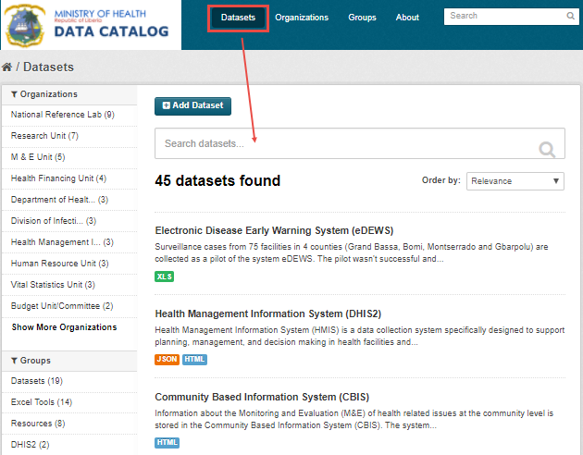
Datasets Tab
Public datasets will be visible to everyone.
Private datasets will be visible only to the members of the organization the dataset belongs to.

Slide 21
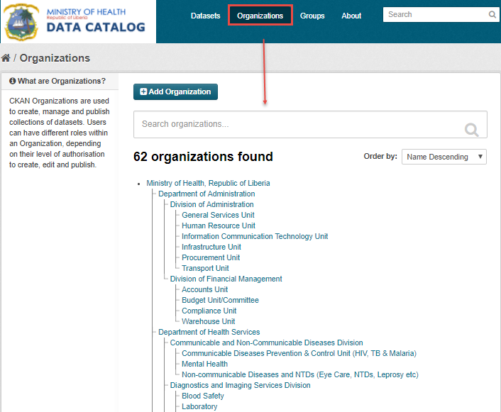
Organizations Tab
Each and every dataset must belong to an organization.
Notes:
Note: to have the organization displayed properly, need to change to Order by to “Name Descending”. eHA technical team is working on improving this..

Slide 22
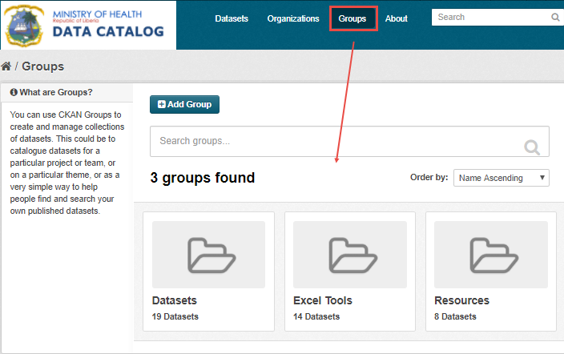
Groups Tab
Datasets: dataset from software applications
Excel tools
Resources: reports, articles, SOPs, etc

Slide 23
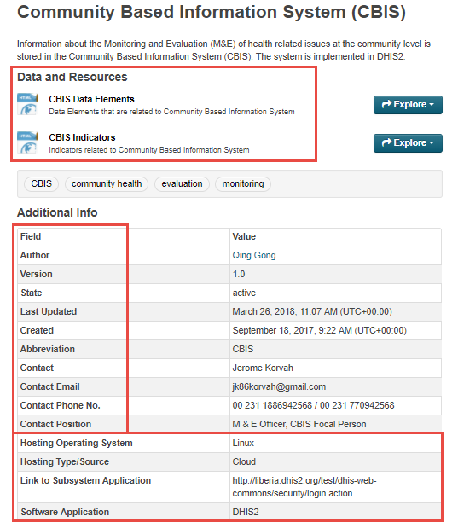
Dataset
Data and Resource for datasets
metadata of the HIS subsystem
Additional Info for datasets:
Hosting operating system
Hosting type/source
Link to subsystem application
Software application
Notes:
The Additional Info for all categories of datasets are composed of two parts
Common for all categories of datasets, from ‘Author’ - ‘Contact Position’
Differs depending on the category of the dataset

Slide 24
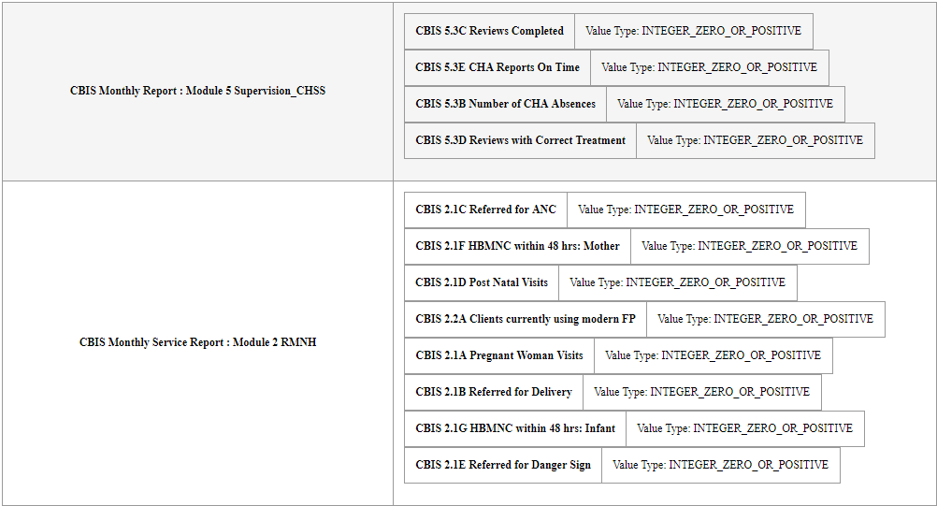
CBIS Data Elements
Notes:
Presented in HTML format

Slide 25
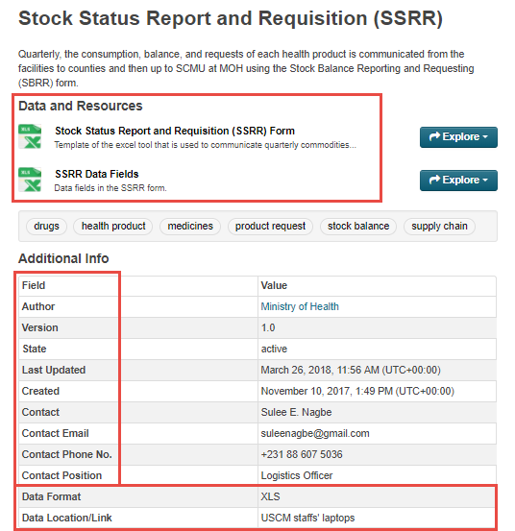
Excel Tool
Data and Resource for Excel tool
Excel sheet template
Data fields
Additional Info for Excel tool
Data Format
Data Location/Link

Slide 26
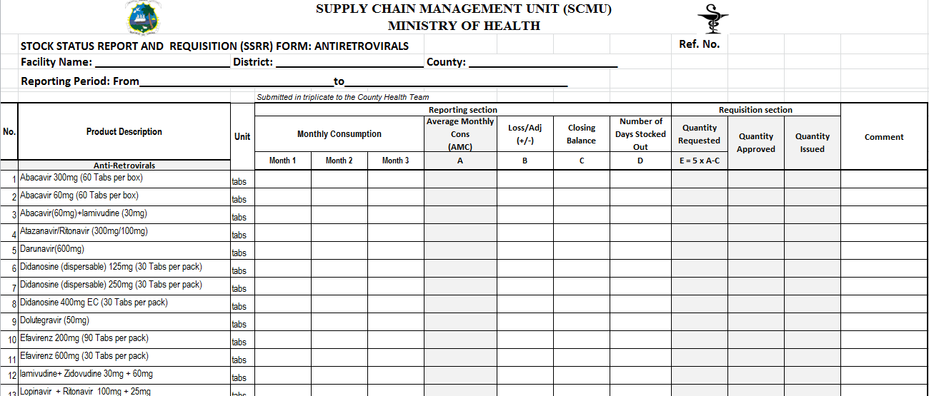
SSRR Form

Slide 27
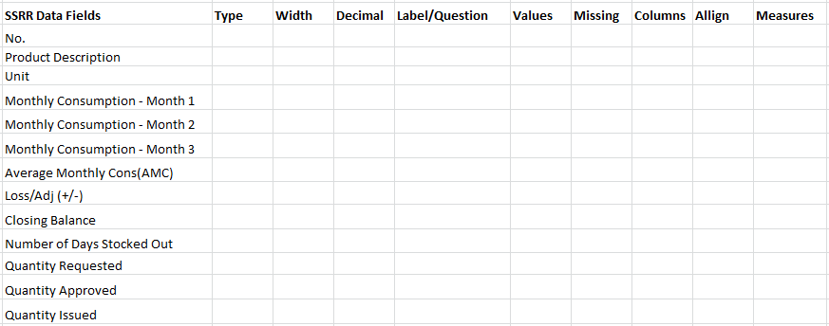
SSRR Data Fields
Need access to SPSS to generate the metadata/ codebook
Notes:
The empty parts are to be filled. We can get the information by using SPSS to generate codebook for the excel sheet.
For some Excel tools, when the name of the data fields are not self-explanatory, a description column will be added.

Slide 28
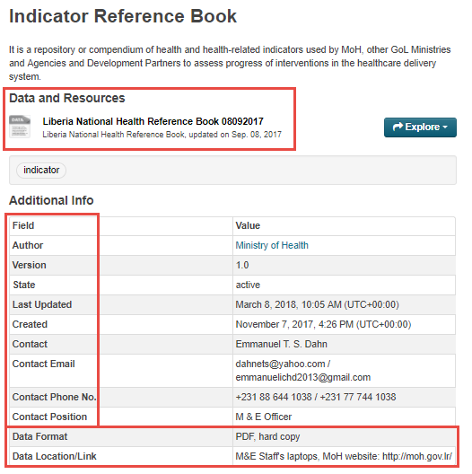
Resource
Data and Resource for Resource
Link to location if resources are stored in another online location.
Or actual data if resources are only stored locally
Additional Info for Resource
Data Format
Data Location/Link

Slide 29
Thank you. :)

